Slide 1
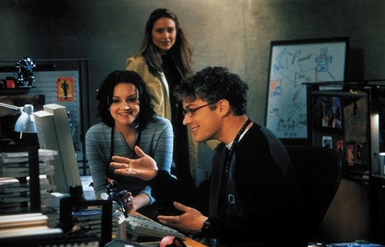
Password War Games
Part II: Best Practices, Password Acquisition Methods, and Defenses

Slide 2

Loose Lips Sink Ships
Password Best Practices

Slide 3
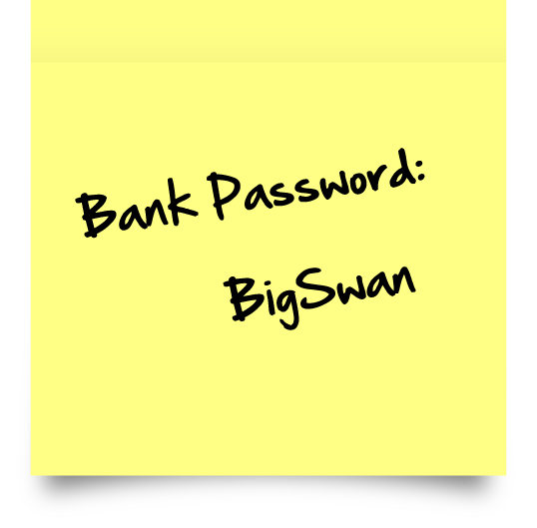
Hide & Seek
Do Not Write Down Your Password — Never store your password on paper. Come up with a good memory scheme.

Slide 4
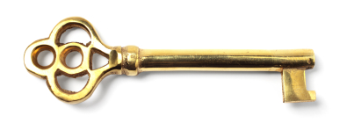
The Golden Password
Do Not Use the Same Password For All Machines — i.e. This is called a gold or golden password. Crackers love them. It is important that you make separate passwords for each account. This way if one system is compromised, all of your machines/accounts/data will not immediately be at risk.

Slide 5
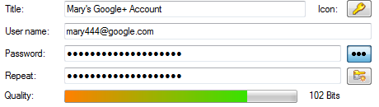
Password Length
Make the Password At Least Ten Characters Long (depends on risk)
The longer the password, the better
Most firms have a minimal acceptable
length that they consider strong
Use longer passwords for more sensitive data

Slide 6
Alphanumerics
Mix Letters and Numbers — Adding numbers to passwords, especially when added to the middle (not just at the beginning or the end), can enhance password strength.
  Where n = length of password
  Lower case alphabet = 26^{n} combinations
  Alphabet + numbers = (26+10)^{n} combinations

Slide 7

Mixed Case
Mix Upper and Lower Case Letters — By mixing cases, you will enhance the strength of the password.
  Where n = length of password
  26^{n} versus (26+26)^{n}
  ^{26 combinations of lowercase} , 52 combinations of mixed case

Slide 8
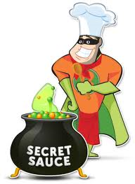
Special Sauce
Including Special characters such as &, $, #, >, … can greatly improve the strength of a password
  Where n = length of password
  Lower case only = 26^{n}
  Mixed case = (26+26)^{n}
  Mixed case + numbers = (26+26+10)^{n}
  Mixed case + numbers + special char = (26+26+10+20)^{n}

Slide 9
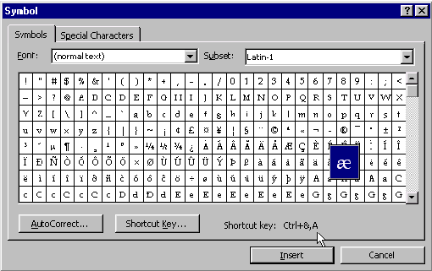
Very Special Characters
Some special keyboards or input tables allow you use the entire ASCII character set (256 possible combinations per character). This makes life rough for password cracking software.
  Where n = length of
  Password, then
  256^{n}

Slide 10
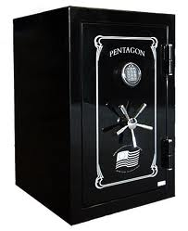
Password Pragmatism
Pick a Password You Can Remember — The best password in the world does you little good if you cannot remember it or feel you have to write it down.
Use acronyms or other mnemonic
devices to aid in memorizing
passwords or use a “Password
Manager” program

Slide 11
Password Checkers vs. Password Cracking
Most password strength checkers will not discover certain types of bad passwords.
Organizations should use password cracking software as part of their audit procedures
Most password are not as sophisticated as actual password cracking programs.
Example: Procr4$tin4te
  i.e., a password checker might accept this password, while a good cracking program will easily break this.

Slide 12
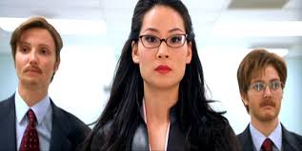
Password Subterfuge
Snooping and Social Engineering

Slide 13
Password Acquisition Methods (1 of 3)
Theft
Search - Passwords written down: under keyboard, on monitor, on wall, in desk drawer, under leaf of plant, under plant pot
Bribery
Coercion/Extortion/Subversion/Blackmail
Social Engineering (phishing, impersonation,…)

Slide 14

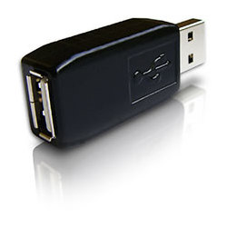
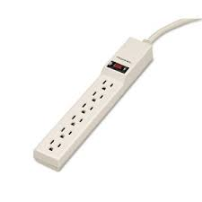
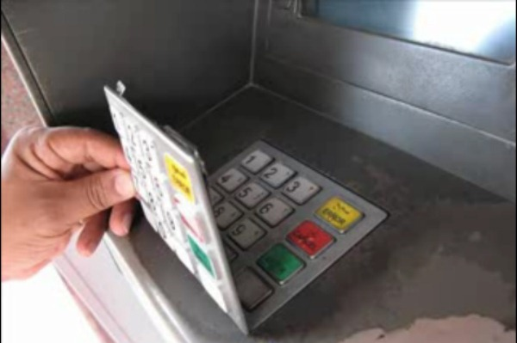
Password Acquisition Methods (2 of 3)
Insider (admin, users, someone has access to password database)
Sniffer (to include wiretapping, rogue devices, wireless sniffing, could be insider assisted.)
Keylogger (hardware or software)
Logon spoofing (to include ATM spoofing)

Slide 15

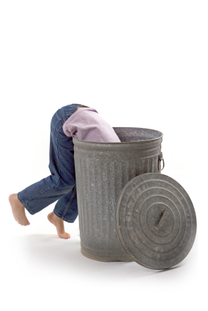
Password Acquisition Methods (3 of 3)
Shoulder surfing (to include use of hidden or spy cameras)
Keyboard “Audio” detection
Dumpster diving
Access to password databases (safe, admin access,…)

Slide 16

Password
Counter Intelligence

Slide 17
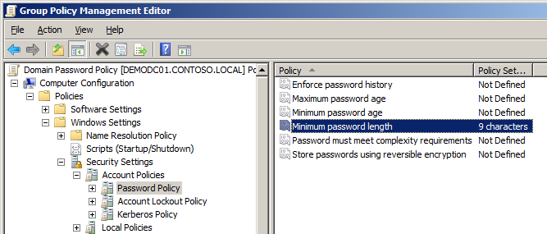
Policies
Password Policies
  Password Use Policies
    Don’t give your password to anyone
    Don’t use the same password on multiple accounts
    Password strength (length and character complexity)
    Required use of password manager software
  Logon, Aging, and Lockout Policies
    Logon process should not indicate if you typed in a valid username
    Delay of login response should be the same for correct and incorrect logins
    Lockout policies (time and tries)
    Password age
    Password history

Slide 18

Checking and Auditing
Password Checkers
  Password Policy Tester
  Password Defender
Password Auditing
  Auditing for weak passwords using password crackers, e.g. ophcrack, John the Ripper, …
  Sniffing
  Physical security audits and Pen Testing

Slide 19

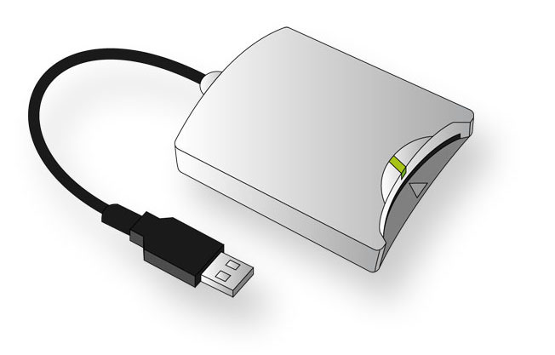
Multi-Factor and Non-text Input Methods
Multiple factor authentication:
  RSA tokens
  Knowledge based redundancy
  Smartcards
  Yubikey
  SMS
  Biometrics
  Location-based
Graphical passwords
Virtual keyboards

Slide 20
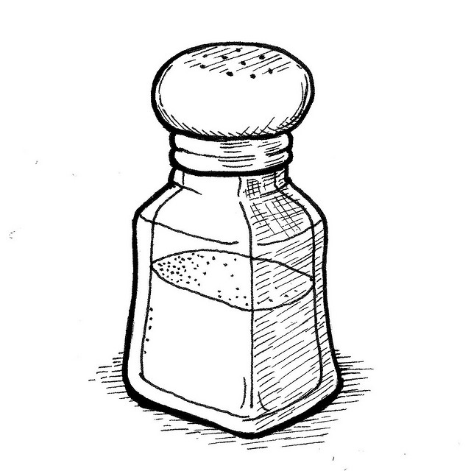
Defenses
Education
Do not store or transmit passwords in the clear
Logging (login failure attempts)
Slower encryption methods (password hashing, e.g. SHA-crypt, bcrypt)
Password salts – Response to use of rainbow tables (i.e. pre-computation attacks)
Use of local parameterization
Use of password stretching (configurable iteration counts)

Slide 21
User Education
Understanding of basic password math
Password Policies – Why?
See a demo of a password cracker in action
Understand the four basic cracking techniques – How and why they work?
Understand password operational security :
  DO NOT: write down, give to other people, use same password on multiple accounts
  Be aware of basic social engineering methods that crackers may use to try and trick you into revealing your password

Slide 22
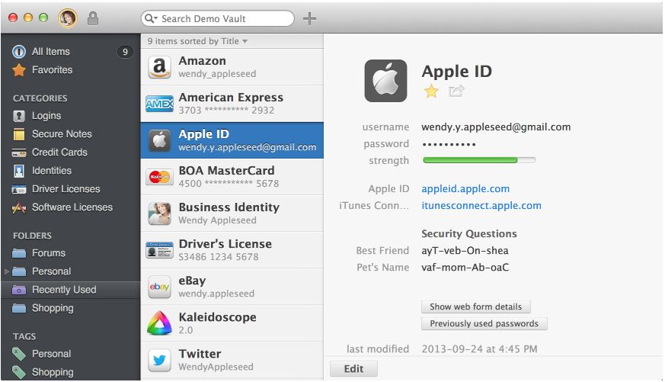
Password Manager: 1Password
Very Easy to Use
Organize your passwords
Random password Generator
Password Audit
Browser plug-in
Sync everywhere
Multiple and shared vaults
Secure notes

Slide 23

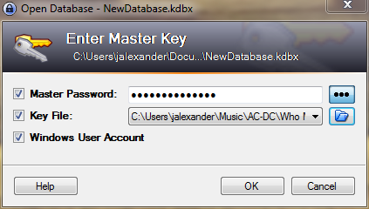
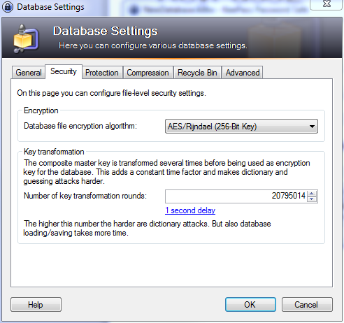
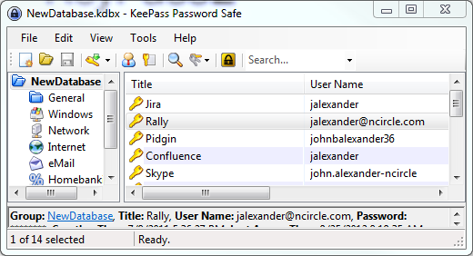
Password Manager Example: KeePass
Easy to Use
  Drag-n-drop
Hard to Get Into
  Composite Master Key
  Key Transformation (Stretching)
Random password Generator

Slide 24
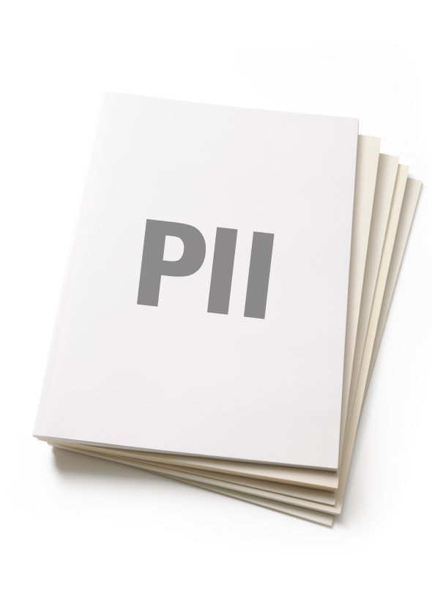
Personal Identifiable Information Reference
Names: (first, last, middle, maiden, hyphenated, ranks, titles), Names of relatives, friends, pets (to a lesser extent acquaintances), Nicknames
Addresses (home, addresses of relatives and friends, offices, current, old addresses, numbers, street names, city names, state names, country names)
License plate (all vehicles owned by victim to include previous vehicles)
Drivers license number (to include numbers of acquaintances)
Schools: Name of schools (elementary, middle, HS, college, fraternities, clubs)
Telephone numbers (home, cell, work, relatives, friends, office, contacts)
Social security number, account numbers, identification numbers, …
Dates: Birthday (victim, relatives, friends, pets), anniversaries (wedding, engagement, special occasion, graduation), astrological signs
Room numbers, office numbers
Clubs and military: Unit names and designations
Favorites: Colors, music groups, songs, actors/actresses,
auto models, movies, books, food, wine, hobbies, sport teams,…
Web: urls of favorite sites

Slide 25
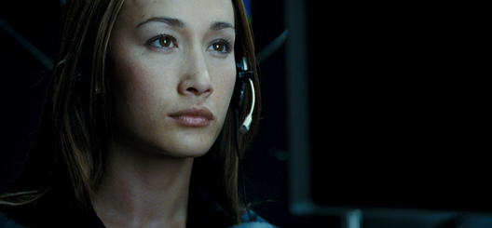
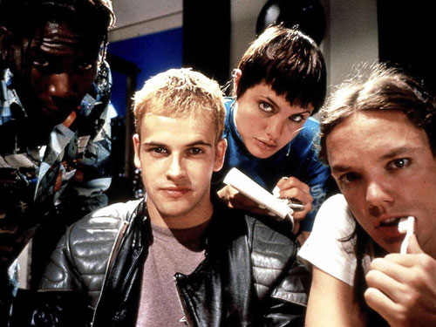
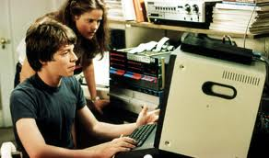
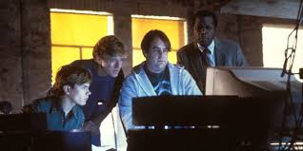
Questions

